Slide 1
CHAPTER 10
Observational Studies

Slide 2
What is Field Research?
Leaving the lab!
Field research attempts to examine behavior in its “natural habitat”

Slide 3
How is Field Research Conducted?
The researcher observes
  Systematically records the behavior of individuals to describe the behavior
Results are used simply to describe the variable being studied

Slide 4
When to use Field Research?
Topics that defy simply quantification
Attitudes and behaviors best understood in their natural setting (Naturalistic Observation)!
Examples?

Slide 5
Behavioral Observation
Two measurement problems:
  Observations are subjective!
  It is essential that the behaviors are not disrupted or influenced by the presence of an observer

Slide 6
Behavioral Observation
Reactivity – Subjects may react to the fact of being studies, altering their behavior from what it would have been normally.
  Participants act differently if they know they are being watched!

Slide 7
Field Research types
Naturalism – Assumes that an objective social reality exists and can be observed and reported accurately.
  “Learn by watching”
  Is our experience of reality subjective? If so naturalism might not always be accurate.

Slide 8
Types of Observation
Naturalistic observation
  No researcher intervention
Participant observation
  Researcher interacts with participants and becomes one of them
Systematic observation
  Researcher sets up a situation likely to produce the desired behavior in participants

Slide 9
Field Research Example
Isen & Levin (1972) Study of helping behaviors
Research Question: Will individuals who have been helped in some way be more likely to help others?
Scenario: Researchers observed individuals at a pay phone. Half “randomly” found a dime in the change slot. Participant then observes a confederate drop a stack of papers. Will people who found the dime be more willing to help than the control group?
Yep! Almost 100% of those who found a dime helped (vs. 1/25 in the control group….)

Slide 10
The Case Study Design
In-depth study and detailed description of a single individual (or a very small group)
  May involve an intervention or treatment administered by the researcher
Case history: a case study without any treatment or intervention

Slide 11
Case Studies
Case studies/histories describe a phenomenon
  They’re descriptive in nature
    “Just observe and report”
  Cannot establish causation! (Need more participants!)
  Useful when we can’t ethically manipulate something!

Slide 12
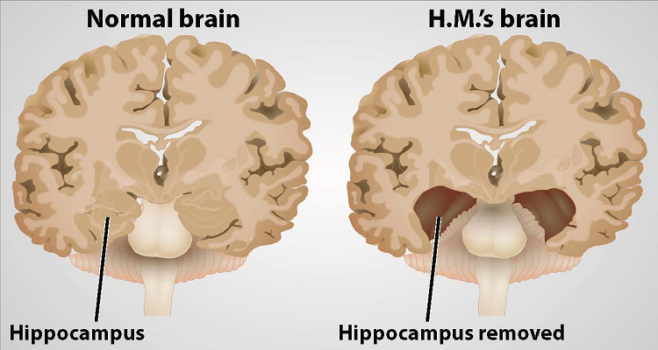
Case Study Example: HM
Suffered from severe epilepsy
At age 27 underwent experimental surgery to remove his hippocampi

Slide 13
Conducting Qualitative Field Research
Qualitative Interview – Based on a set of topics to be discussed in depth rather than based on the use of standardized questions.
NOT the same as an interview survey!
Survey == set of standardized questions, Qual interview == more informal, topical

Slide 14
Conducting Qualitative Field Research
Focus Group – A group of subjects interviewed together, prompting a discussion.
  Advantages: real-life data, flexible, high degree of face validity, fast, inexpensive
  Disadvantages: ???

Slide 15
Conducting Qualitative Field Research
Focus Group – A group of subjects interviewed together, prompting a discussion.
  Advantages: real-life data, flexible, high degree of face validity, fast, inexpensive
  Disadvantages: not representative, little interviewer control, difficult analysis, interviewer/moderator skills, difficult logistically

Slide 16
Strengths and Weaknesses of Qualitative Field Research
Strengths of Qualitative Field Research
  Effective for studying subtle nuances in attitudes and behaviors and social processes over time
  Flexibility
  Inexpensive
Weakness of Qualitative Field Research
  No appropriate statistical analyses

Slide 17
Strengths and Weaknesses of Qualitative Field Research
Validity?
  Greater validity than survey and experimental measurements
  Especially external validity!
Reliability?
  Potential problems with reliability
  Is one person or group representative of population?

Slide 18
Ethics in Qualitative Field Research
Planning and conducting responsible field research involves confronting ethical issues that arise from the researcher’s direct contact with subjects.
Confidentially/Anonymity

